Slide 1
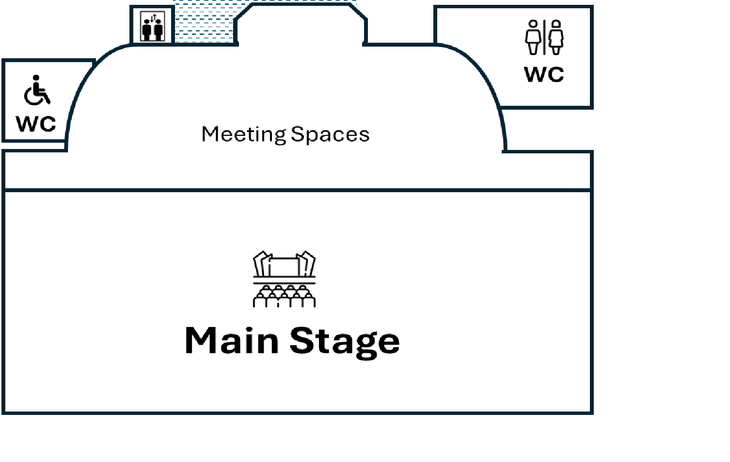



Smoothie Station
Coffee Station
UG

Slide 2
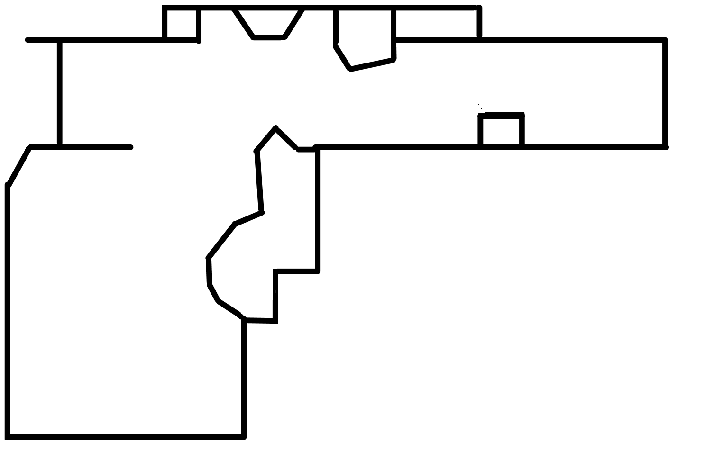














WC
CheckIn
Catering
Catering
Bar
EG
Meeting Spaces

Slide 3
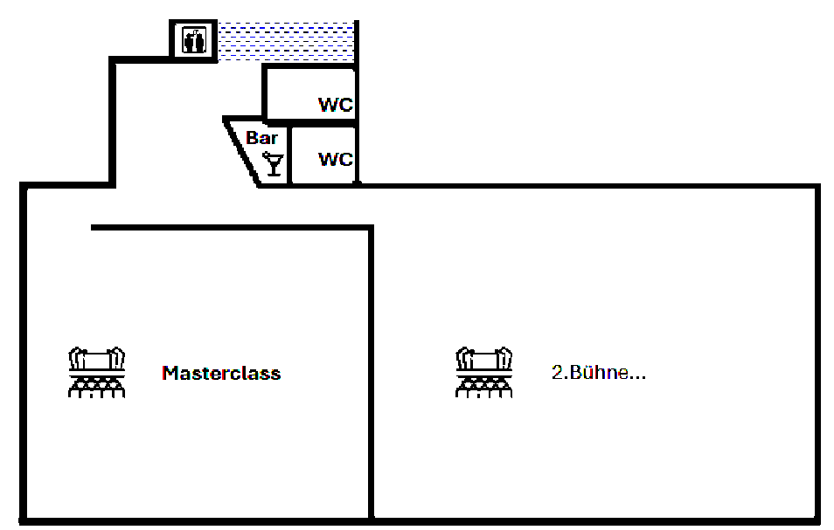




OG
WC
Bar​
WC
Cloakroom
Masterclasses

